Slide 1

Developing Great Web APIs Architectures with ASP.NET 8
Chris Woodruff

Slide 2
Chris Woodruff
cwoodruff@live.com
Twitter – @cwoodruff
Architect at Real Time Technologies Inc

Slide 3

Resources
GitHub
Solution Demo
https://github.com/cwoodruff/Chinook7WebAPI
GitHub
Workshop
https://github.com/cwoodruff/web-api-workshop
Online Docs
Workshop
https://cwoodruff.github.io/web-api-workshop/

Slide 4

What do you and I do wrong?
ASP.NET Core 8 Web API Architecture

Slide 5
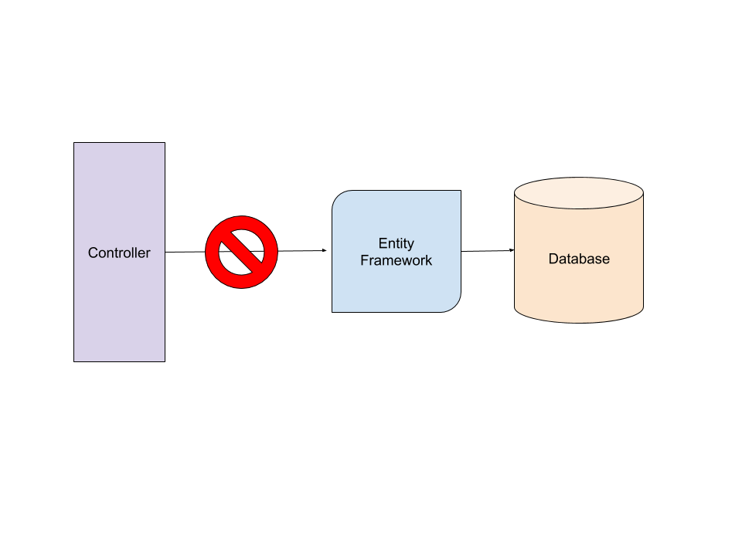
Bad Habits
Calling Data Access functionality (EF Core) from Controllers

Slide 6
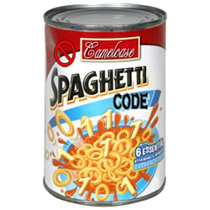
Bad Habits
Having all code in a single project. Hard to test!

Slide 7

Bad Habits
Coupling your Data Access (EF Core) to your project Domain

Slide 8

Bad Habits
Not thinking about Unit or Integration testing

Slide 9
What does ASP.NET Core help us with?
ASP.NET Core 8 Web API and Architecture

Slide 10

Understand the HTTP Protocol

Slide 11
How I build my API’s
API
Domain
Data
Tests

Slide 12
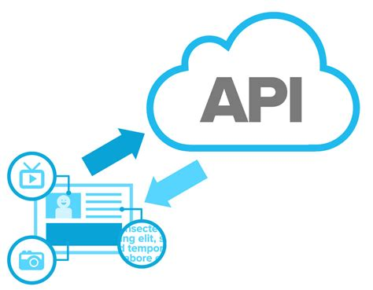
API Layer

Slide 13
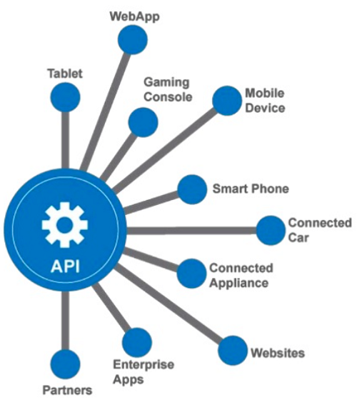
API Layer
Like the UI of an ASP.NET MVC (or any web platform and pattern), the API endpoints should not know about the Domain knowledge or Data Access

Slide 14
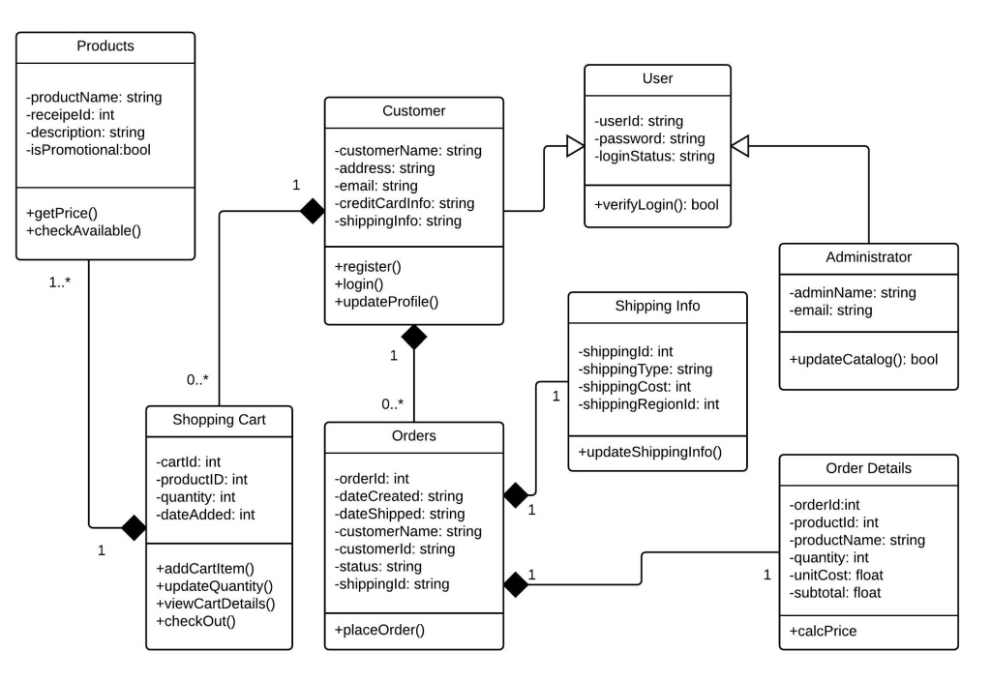
API Layer
Should interact with consumers with ApiModels to ensure the greatest flexibility

Slide 15
Public class Album { public string? Title { get; set; } public int ArtistId { get; set; } public Artist? Artist { get; set; } public ICollection<Track>? Tracks { get; set; } }
public class AlbumApiModel { public string? Title { get; set; } public int ArtistId { get; set; } public string? ArtistName { get; set; } public ArtistApiModel? Artist { get; set; } public IList<TrackApiModel>? Tracks { get; set; } }

Slide 16

Domain Layer

Slide 17
Domain Layer
Contains both my Entity models and my ApiModels for the solution.

Slide 18

Domain Layer
Contains all my interfaces for Data Retrieval so I can keep a well-defined standard for my data access.

Slide 19

Domain Layer
Allows me to use Dependency Injection for Repositories

Slide 20
Domain Layer
Think of the Domain Layer as the Supervisor!

Slide 21

Data Layer

Slide 22

Data Layer
Where all the heavy data lifting happens

Slide 23
Data Layer
Everything defined based on Interfaces from the Domain Layer

Slide 24
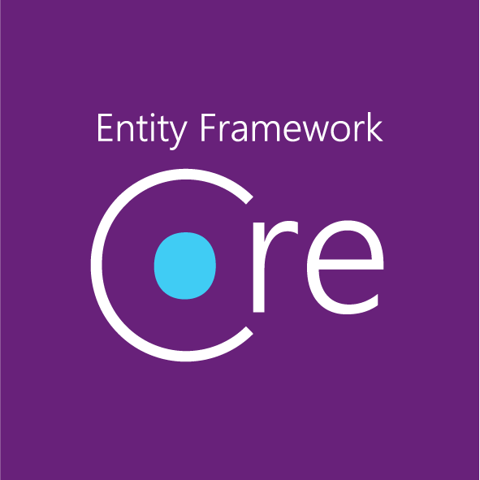
Data Layer
I use Entity Framework Core 8 but we can use anything like Dapper or SQL JSON

Slide 25

Data Layer
I also Mock up a data layer for testing

Slide 26

Caching

Slide 27
Caching for APIs
Response Caching
In-Memory Caching
Distributed Caching

Slide 28
Response Caching
Directs Caching on the consumer side
HTTP 1.1 Caching specification
Attribute on Controller or Action
[ResponseCache(Duration = 60)]
Response Header:
Cache-Control: public,max-age=60
[ResponseCache(Location = ResponseCacheLocation.None, NoStore = true)]
Response Header:
Cache-Control: no-store,no-cache
Pragma: no-cache

Slide 29

In-Memory Caching
Directs Caching on the consumer side

Slide 30
Distributed Caching
Distributed caches can improve the performance and scalability of ASP.NET Core apps, especially when hosted in the cloud or a server farm.
Cached data is coherent on all web servers. Users don't see different results depending on which web server handles their request
Cached data survives web server restarts and deployments. Individual web servers can be removed or added without impacting the cache
The source data store has fewer requests made to it (than with multiple in-memory caches or no cache at all)

Slide 31
Distributed Caching
Local Redis Cache
SQL Server Cache
Azure Redis Cache
Amazon ElastiCache
Google Cloud Memcache

Slide 32

Testing

Slide 33
Tests
I have 2 types of tests: Integration and Unit
Integration for API endpoint testing and Controllers
Unit Testing to cover the Repositories and Supervisor

Slide 34
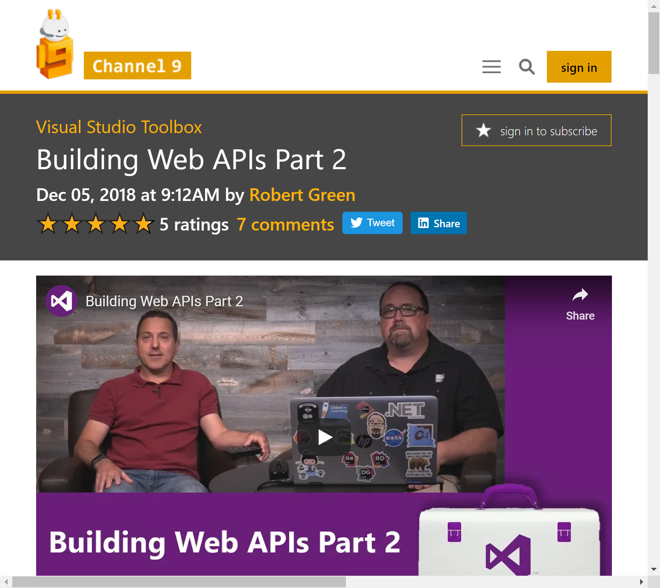
https://channel9.msdn.com/Shows/Visual-Studio-Toolbox/Building-Web-APIs-Part-2

Slide 35
Anything to ask?
ASP.NET 5 Web API and the Hexagonal Architecture

Slide 36
Thanks!
Twitter
@cwoodruff
GitHub
https://github.com/cwoodruff
Email
cwoodruff@live.com
Sample project
https://github.com/cwoodruff/Chinook7WebAPI
Workshop
https://cwoodruff.github.io/web-api-workshop/

